Slide 1
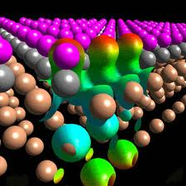
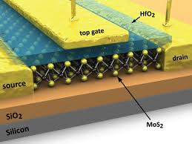
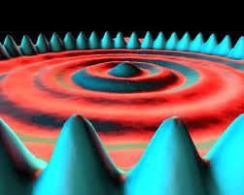
Physics 341/342: Advanced Lab Professor Micky Holcomb 437 White Hall mikel.holcomb@mail.wvu.edu https://community.wvu.edu/~miholcomb/phys341.html
Today: Introduction to me, you, class structure and error analysis
Notes:
Lost some time due to lost internet on first day of class (of course). Barely finished pretest.
Notes to self: Dropped periodic table stuff. I generally talk about this later anyway and the Kittel layout doesn’t make sense to start with this topic.

Slide 2
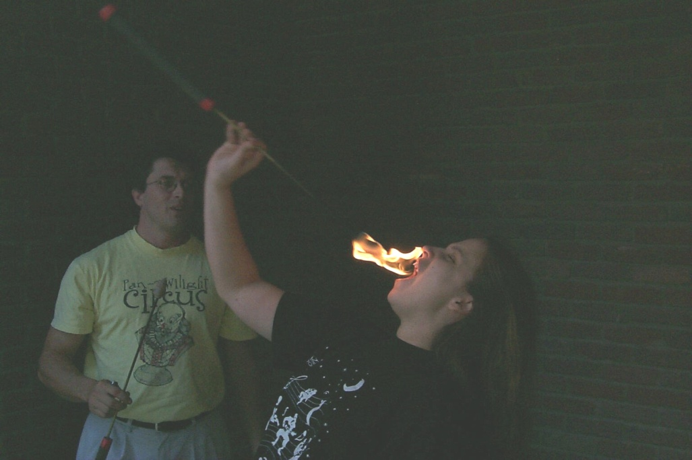
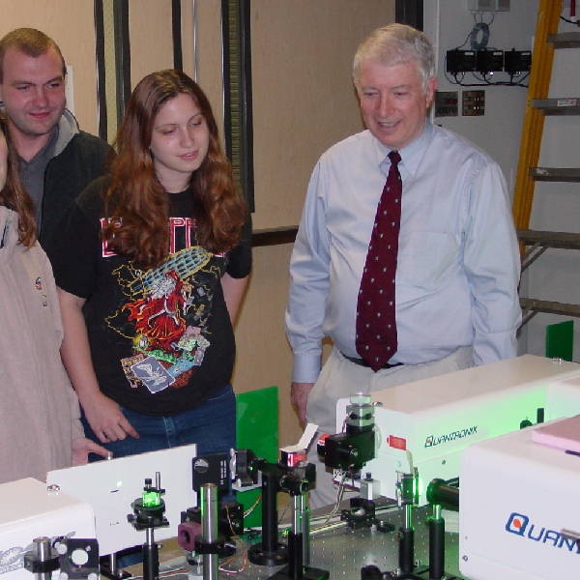
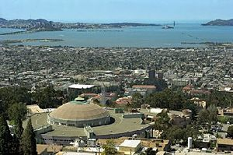
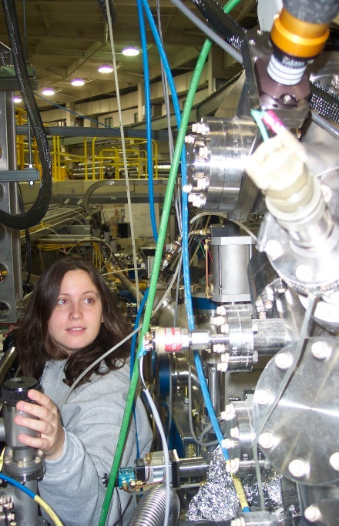
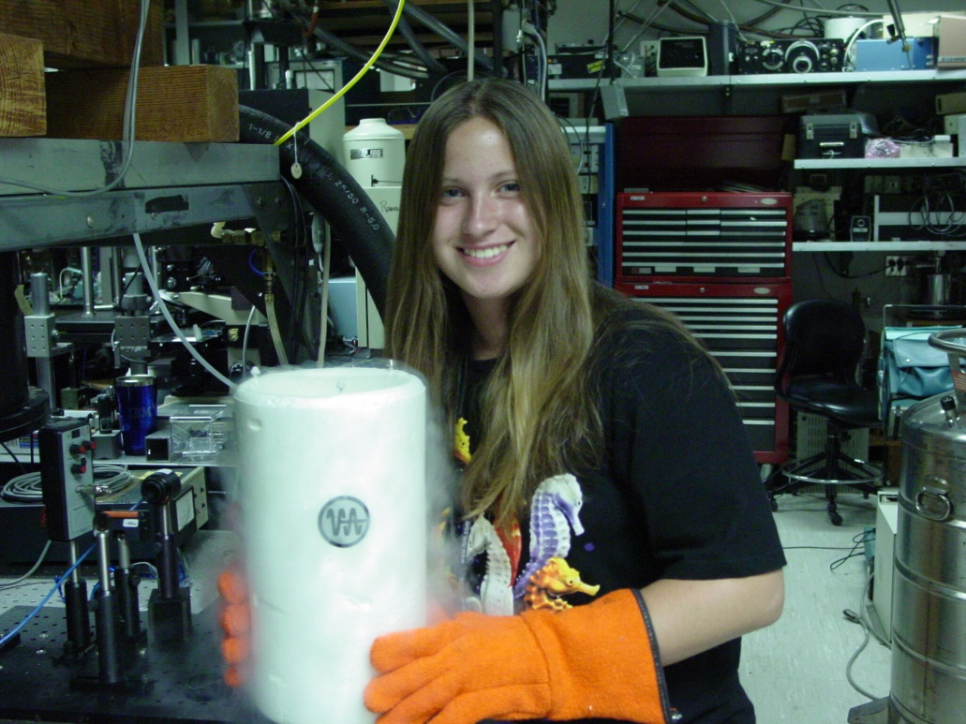
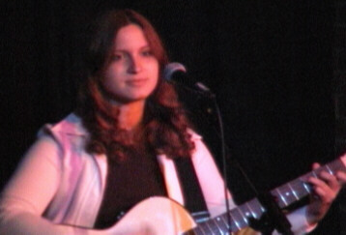
About Your Professor
Went to school at Vanderbilt and Berkeley
Did graduate work at a national lab
Did internship at IBM on quantum computing
Grew up in middle of nowhere Kentucky

Slide 3
About Your Professor
Went to school at Vanderbilt and Berkeley
Did graduate work at a national lab
Did internship at IBM on quantum computing
Toyed with a non-scientific internet startup
Decided I liked research AND teaching

Slide 4
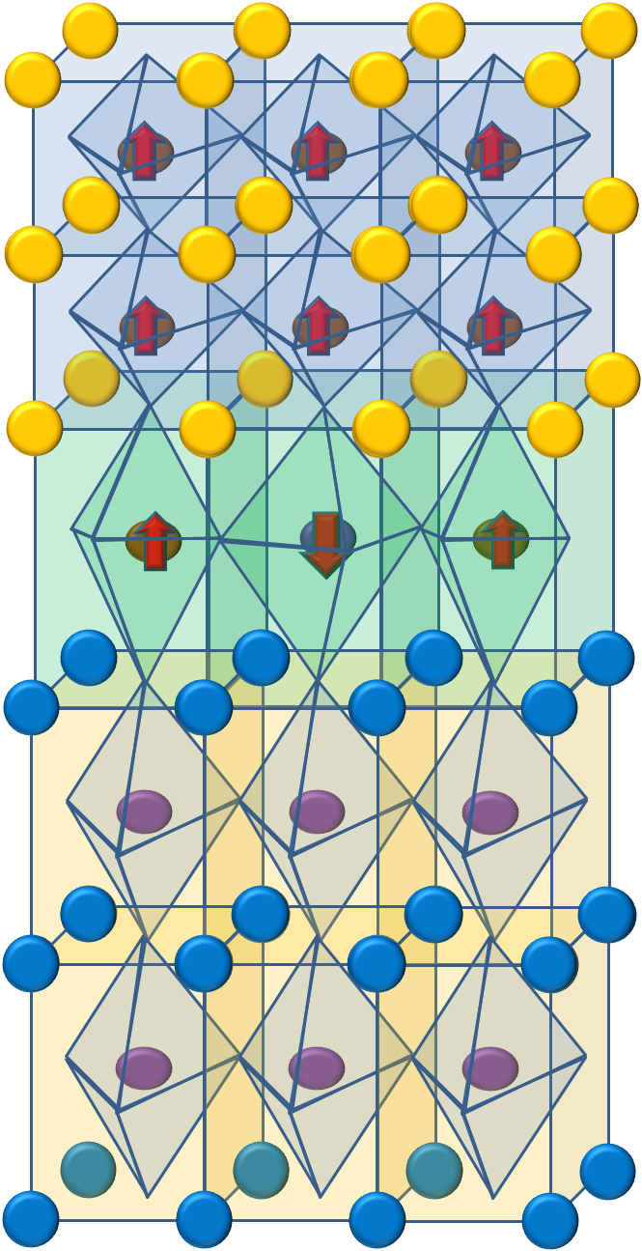
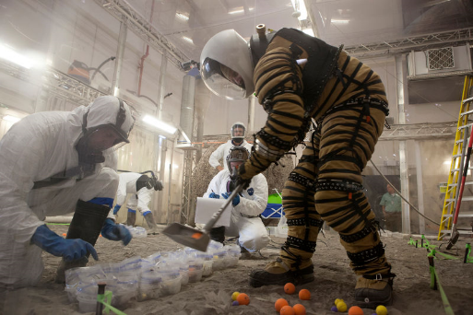
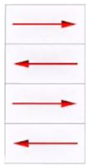
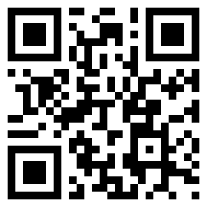
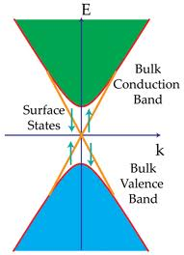
My Work: Surface & Interface Physics
Magnetic Dead Layers
Helping NASA optimize their new single photon detectors
Lot of element specific beamline work
Delafossites ABO₂
Topological Insulators
Perovskites ABO₃ layers
Notes:
3 slide intro to my work
Brief summary of the topics I will not focus on today, but we work on.

Slide 5
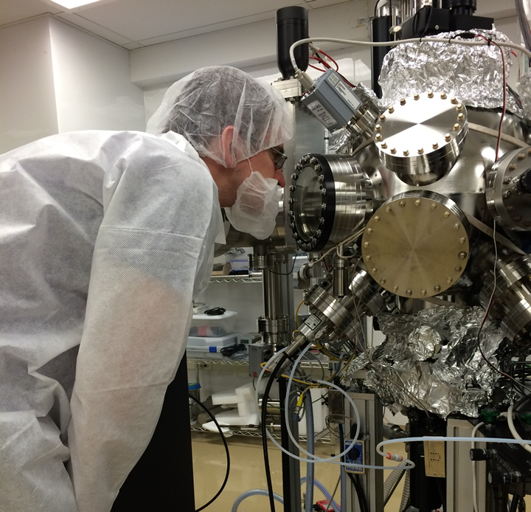
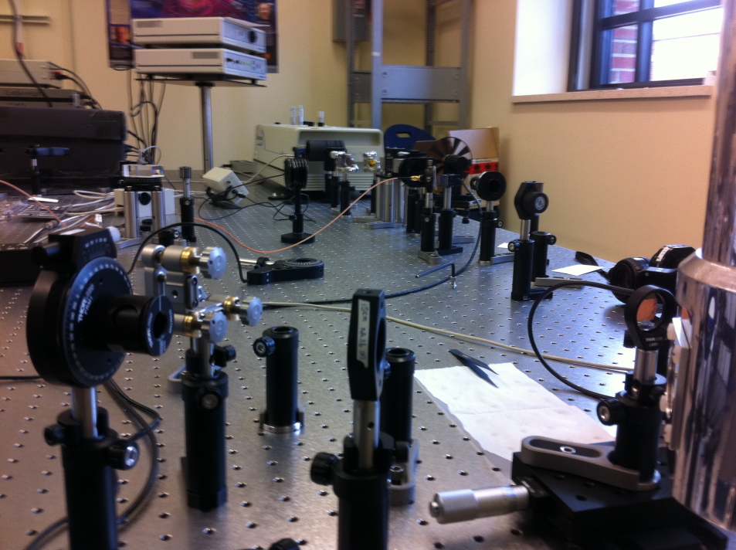
Measurement Techniques
WVU: Growth & Nonlinear Optics
San Francisco
Synchrotron Techniques At National Labs:
X-ray Absorption Spectroscopy
Photoemission Electron Microscopy (PEEM)
Beyond the standard techniques (XRD, VSM, TEM, etc.), we focus on unique interfacial measurement techniques.

Slide 6
As we are about to spend a lot of time together, please introduce yourself.
Name
Where from
Year
Planned career path (or possibilities, if debating)

Slide 7
Key Goals of This Course. Guesses?
Integrate knowledge from your classes
Gather/review needed material independently
Design experiments that aren’t spelled out
Communicate the key ideas and findings of your work
Determine various types of uncertainty (measurement, slope and propagation)
Use this uncertainty to evaluate the success of your experiment
If unsuccessful, suggest likely reason(s). If successful, suggest improvements that could make it even better. Better yet, go ahead and try.

Slide 8
In Other Words…
This class is designed to guide you through the typical steps necessary to do scientific work, whether that is in academics or elsewhere.
These are highly marketable job skills!

Slide 9
Given these goals, how do you think you’ll be assessed?
Lab Notebook (13 points X 2 labs) Breakdown:
Preparation for your experiment (pre-lab) 3 pts
Documentation of your data collection 4 pts
Summing up your conclusions (post-lab) 3 pts
Uncertainty 3 pts
Written Report (13 points X 2 labs)
Oral Communication: End of Semester Poster (10 points) and Talk (10 points)

Slide 10
Because the extensive list in the syllabus lead to people missing things, I made a few changes:
I have spread out the experiments (more time)
I made another rubric that emphasizes the most critical things I look for when grading (Note: I will still use the grading scheme in the syllabus, but I believe the rubric will help you better determine if you have the most critical parts.)
I am requiring check-ins for the pre-lab, written report and end of semester poster
Notes:
The 3 experiment blocks were also confusing, but they are needed when we have a large class size

Slide 11
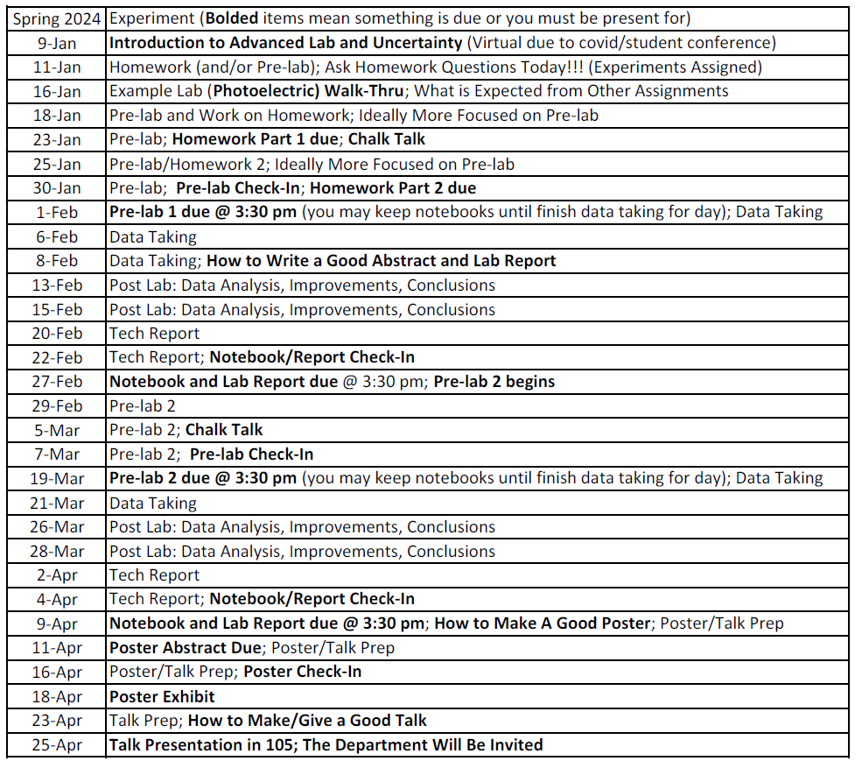
Spring 2024 Schedule

Slide 12
Let’s take a look at some examples of lab notebooks and lab reports
What are things you notice?

Slide 13
Any Questions about Class Structure?
I’d now like to get through as much of a discussion on uncertainty as we can, such that you could feasibly finish your homeworks next week and move on to your pre-lab. It’s ok, however, if it takes you longer. I recommend that if you get stuck, move on to your pre-lab. Ideas often come to you when you aren’t banging your head against the wall trying to make sense of it.

Slide 14
Correctly dealing with uncertainty/error is one of the big goals of this lab (graded accordingly)
That means:
Reasonable use of significant figures
Every measured and calculated number has a reasonable error written down with it
The error is correctly propagated
Plots are linearized and the slope and the error in the slope are correctly given. (It should also be clear how this slope relates to whatever you are trying to find.)
Notes:
Measurement error
Propagation of error
Slope error

Slide 15
When it is not obvious how error should be defined
In real research, it is not always obvious how to define error in a variable. Thus, it is important to be very clear (with words and diagrams) about how you define that error.
In the last part of charge to mass, you’ll be looking for what values of E and B result in a straight-ish line. Your error for E and B is then how much can you move it before it is no longer straight-ish. People might have different opinions on what straight-ish is, and that’s ok. But, it’s very important that you document your decision. You’ll want to at minimum take a picture of what the boundary of straight-ish looks like.
Another example is the photoelectric effect lab. In this lab, the measurement error would give you WAAAAAY too small of an error for the stopping potential. The manual suggests a particular method to find the stopping potential, but it’s not obvious how define an error with this method. Thus, I recommend that you use two different methods of approximating the stopping potential; come up with your own ideas, but I’m happy to discuss ideas with you if you need it. The difference between these two methods should be a pretty good estimation of the error on the stopping potential. Like any non-obvious error approach, you really need to do a good job at explaining in words and with diagrams/graphs what your two methods are. You should show these two methods on at least two of your LED graphs.
Notes:
The photoelectric effect and charge to mass (and ESR) labs have at least one important where the uncertainty in it is not obvious how to define.

Slide 16
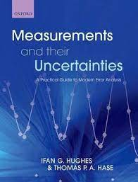
Most Useful Parts of the Book
Chapter 1: Must read (short)
Chapters 2, 4 & 5: Important
Chapter 3: Skip (glance at page 28 for excellent versus reasonable agreement
Chapter 6: Read first 4 pages
You may skip Chapters 7 & 8
Chapter 9: First page critical!
This will be very important for understanding how to do your homework.

Slide 17
Let’s Talk about Uncertainty
Most of this topic is best with examples, so
Give me a guess for what you think the driving distance to Pittsburgh is
Δx = x_{f} – x_{i} Do each of these have uncertainty?
If I say from the parking lot, that could be pretty precise, maybe uncertainty of 0.1 miles.
But saying “to Pittsburgh” isn’t very precise. My uncertainty will be bigger. Let’s say 2 miles.
Do you think 2 miles is right?
Sometimes the amount of uncertainty is subjective. In that case, take your best guess and be clear about how you made that guess!
Notes:
You best guess isn’t likely to be off by more than a factor of 5.
Two miles might be reasonable if I’m thinking like city center, such as google would tell me.

Slide 18
How do you combine uncertainty?
Δx = x_{f} – x_{i} x_{i}=0±0.1 miles and x_{f}=70± 2 miles
One approach is to add them together, but this overestimates the uncertainty a little: would give 70 ± 2.1 miles
A better approach is to take the square root of the sum of the squares. (This is called propagation of errors and every lab this semester has this. Check you do, or you will lose points!)
On board
Notes:
Add written notes here

Slide 19
I get 2.002 miles
Should we report this number as our uncertainty if we were writing this up as a conclusion?
This number has a lot of significant figures. What does that imply?
For this example, how many do you think we should have?
If we were picking a specific place in Pittsburgh, I could probably estimate better. What if I listed 6 significant figures? Sound appropriate to you?
Notes:
Probably just one. “to Pittsburgh” is pretty vague. If we instead said to a particular location in Pittsburgh, we could probably get it to 2 or 3 significant figures.
No, 6 sounds way too many. I’m not likely to get on you about significant figures unless you use way too few or way too many. I want you to think about it and use what you think is best.

Slide 20
Significant figures
I’m not likely to get on you about significant figures unless you use way too few or way too many.
I want you to think about it and use what you think is best.
If I think it should be 2, but you use 3, I probably won’t say anything. But if you use 4 or 5, I will count off. If it should be 3, and you use 1, I will also say something.
You may round at the end, but don’t forget.

Slide 21
How many significant figures does 70 ± 2 miles have?
It’s tricky with this one.
What if the number was 70000 ± 2 miles?
Note that the uncertainty does not have to have the same number of significant digits.
Thus your uncertainty should match with how confident you are in the number.
How do we often make sig figs more clear?
7.0000 ± .0002 x10⁴ miles
Note: Scientific notation isn’t typically necessary, but it is a helpful tool to help you think about if you are rounding appropriately.

Slide 22
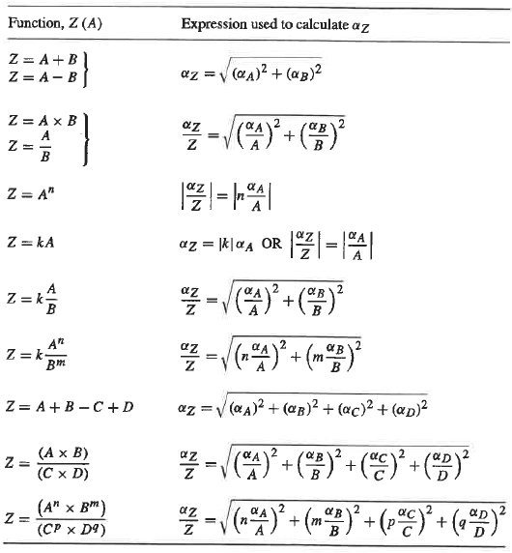
How do we propagate errors when our formula is more complicated?
Chapter 4 goes over the calculus, but there is a handy chart that work most of the time
Z = A - B
Δx = x_{f} – x_{i}
Notes:
What if there are 3
Also how you deal with multiple sources of error

Slide 23
Let’s try propagation of errors for speed.
Let’s say that 70 ± 2 miles took us one hour and I want the uncertainty in speed.
What am I missing?
Notes:
What if there are 3
Also how you deal with multiple sources of error

Slide 24
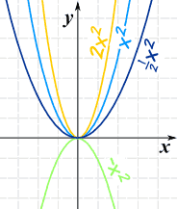
Calculating Slopes, Intercepts and Uncertainty
Excel will gladly calculate the slope and intercept for you with a linear tread, but it will not calculate the certainty for you. You learn how to do that now.
But what if it isn’t linear?
Plot y vs x²

Slide 25
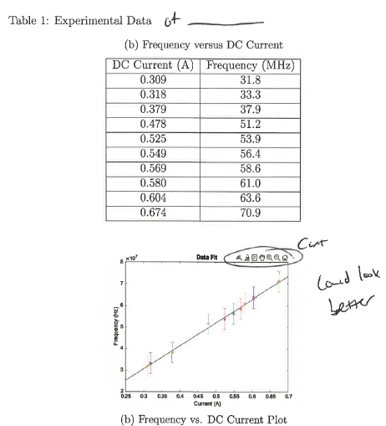
Taken from Student
Minor presentation issues
X
Y
Let’s use this as an example
How you treat this depends a bit on what kind of error bars you have. Let’s first look at how we do this ignoring measurement error bars.
Notes:
Note: They should not have used a constant error bar (more significant issue), but we can still use this as an example
Caleb’s ESR final report, Spring 2023

Slide 26
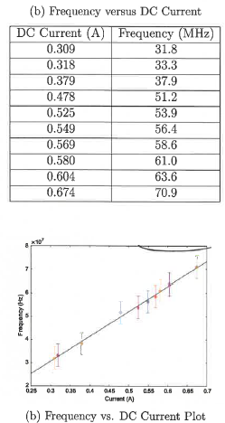
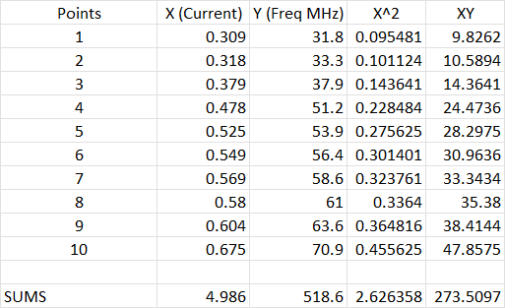
Ignoring Measurement Error (you shouldn’t, educational purpose)
y=mx+c
This is what Excel does automatically.

Slide 27
Ignoring Measurement Error (you shouldn’t, educational purpose)
To get the uncertainties, we have to find the residuals

Slide 28
Adding constant Y error bars
The common uncertainty given currently has nothing to do with measurement uncertainty. We haven’t included it yet.
How you include it depends on the type of error bars you have.
The easiest is if you have y error bars that are all the same magnitude for every point.
What if you have more than one source of constant error?
Notes:
Square root of sum of squares, like error propagation

Slide 29
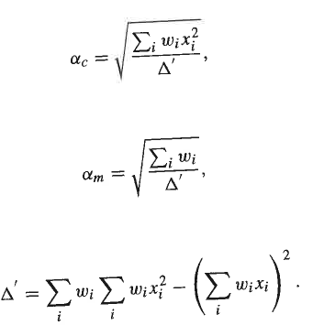
What if your Y error bars vary
Points with smaller error bars count more. You have to weight the points by the inverse square of the uncertainty.

Slide 30
If you have X and Y error bars
Sorry b=m=slope
You use a different weighting, but you may recall that the slope (m or b) depends on the weighting!
What do you think you should do?
Too many sig figs though
Notes:
Change b to m and sigma to alpha. Oops
Use what Excel gives you from a linear trend (or calculate it yourself as discussed in past slides without error bars), plug that slope into the weighting to find a new slope that won’t change very much. Iterate until b doesn’t change anymore.

Slide 31
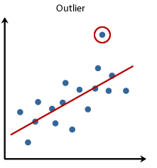
What should you do if you think you have an outlier?
?
Do you have any good reason to suspect why that measurement might not have worked?
Run the data with and without the outlier. If it doesn’t change the result much, I’d generally just keep it, but note that you did it both ways for the reader. They will wonder about that outlier too.
If it does change it a lot and you have reason to suspect that point is wrong, then you may remove that point. You could also considering changing its weight if you have good reason.
DO NOT remove an outlier just because it makes your result closer to what you were expecting. That’s confirmation bias! You may however run the data both ways and point out that removing it brings you closer, but DO NOT only remove.
Notes:
The circled point may or may not be an outlier. Run analysis with and without.

Slide 32
It’s a lot but that’s why we have check ins. You don’t have to be finished, but the more finished you are, but better I can make sure you didn’t miss important stuff (I might not notice everything fyi). It’s kind of like having a progress meeting with an advisor.
Questions?

Slide 33
Course Grading
Recommend looking through the rubrics to make sure you got the most critical items when turning in lab notebook and technical report. More detailed list of expectations are in the syllabus.

Slide 34
Where to Start on Experiments
First: read the experiment description
Description will sometimes encourage other reading, including manuals (manuals are on the class website)
The sample data analysis required for the pre-lab sometimes takes longer than you think so don’t put it off. Once you do it, you’ll basically know what you need to do once you have your own measurements.
Most mistakes will be caught at either the pre-lab check in or when grading the pre-lab. I’m not perfect, so I can’t promise to catch everything; see rubric! When I grade it, I will look over everything more thoroughly, and sometimes that means I notice more things, but even sometimes when grading the pre-lab, it is possible that a misunderstanding could go unnoticed. I do my best, but I can’t read your minds.

Slide 35
Let’s Look at Some Lab Notebooks
What do you notice?
Delayed to next Thursday due to needing to be a virtual class today.

